Slide 1
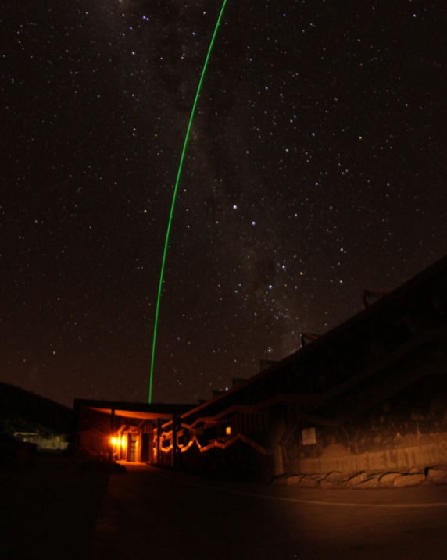
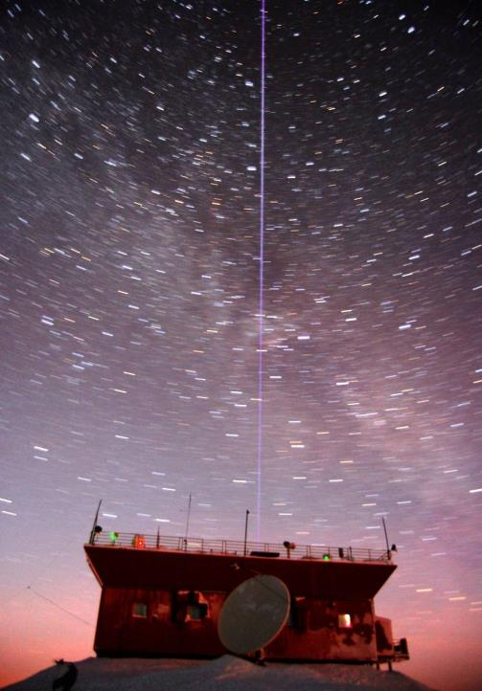
Lidar Working Group
2018 Report
Thierry Leblanc
Wolfgang Steinbrecht
Source: V. Duflot, OPAR
alexey.tikhomirov@dal.ca

Slide 2
12-month summary (1): operational and funded(?), reasonably resolved issues
NH:
Eureka O3/Temp
Thule Temp
Hohenpeissenberg O3/Temp
Payerne Temp/H2O
OHP O3
OHP Temp/Aer/H2O
OHP tropo. O3
Huntsville Tropo. O3
TMF O3/Temp/Aer
TMF Tropo. O3
TMF H2O
MLO O3/Temp/Aer (JPL)
MLO Aer (NOAA)
SH:
Reunion-Maïdo O3
Reunion-Maïdo Tropo. O3
Reunion-Maïdo Temp/Aer
Reunion-Maïdo H2O
Lauder O3 (Temp?)
DDU Aer
Dome C Aer
Mobile:
GSFC TROPOZ Mobile Tropo. O3
GSFC STROZ Mobile O3/T/Aer/H2O
GSFC AT Mobile T/Aer/H2O
12 out of 19 (63%)
are NDACC compliant
measured & submitted data since 09/2017

Slide 3
12-month summary (2): chronic issues, with hope
Garmisch/Zugspitze Aer
unclear instrument, chronic lack of processing, data archiving, but new PI
London Ont. Temp
instrumental problems, no data archiving, but instrument working again
Potenza, H2O/Temp/AER
no routine operation? Submitted 1 month of data
Rome Tor-Vergata, H2O/Temp
technical issues, low budget, short staffed, but submitted data 2003 to 2010
recent measurements EARLINET

Slide 4
12-month summary (3): chronic issues, little hope
Sondrestromfjord Temp
!! station closed !!
Andoya
Laser failure. Replacement planned for several years (no support)
Boulder Aer
Instrument failure, no staffing, re-open 2019?
Rio Gallegos O3/T/Aer
Gas supply, instrument, communication failure
ALVICE Mobile H2O
No funding for NDACC, transferred from GSFC to Howard U./Beltsville

Slide 5
12-month summary (4): The water vapor case…
All H2O Lidars:
almost no data archived despite data format finalization in late 2016
However:
Format update in October 2017: Efforts to push for data archiving ongoing
1 hdf-File by Table Mountain
1 month AMES by Potenza
2003 to 2010 AMES by Rome Tor-Vergata

Slide 6
12-month summary (5)
Past and future campaigns
LAVANDE (phase 1) at OHP, July 2017:
GSFC-STROZ (McGee), LATMOS O3 (Godin-Beekmann), T (Keckhut)
LAVANDE (phase 2) at OHP, March 2018:
GSFC-STROZ (McGee), LATMOS O3 (Godin-Beekmann), T (Keckhut)
Hohenpeissenberg, October 2018:
GSFC-STROZ (McGee), DWD O3 and T (Steinbrecht)
future plans:
Maïdo-Reunion MORGANE-2 (some time in 2019/2020):
GSFC-STROZ (McGee), OPAR O3 (Portafaix), T (Keckhut), H2O (Duflot)
Lauder (2020?):
GSFC-STROZ (McGee), NIWA O3 (and T) (Querel)
Rio Gallegos (20xx):
GSFC-STROZ (McGee), CEILAP O3 and T (Quel, Salvador, Wolfram)

Slide 7
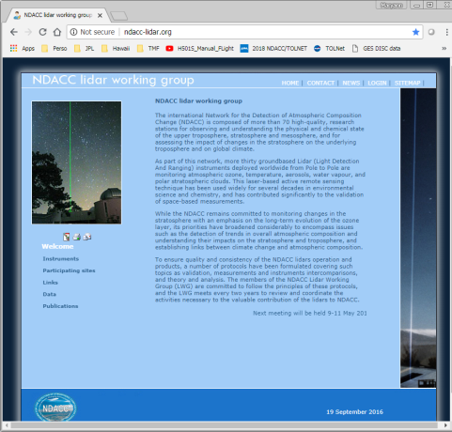
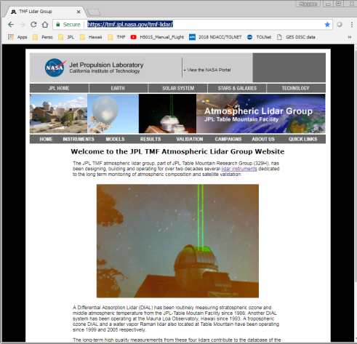
NDACC Lidar Working Group Website
Host Change
Former site managed by RIVM (Netherlands): (hosted by private company)
http://ndacc-lidar.org/
To be discontinued December 2018
New site hosted by JPL-Table Mountain:
https://tmf-lidar.jpl.nasa.gov/NDACC_LWG
Currently under construction (almost finished) To be public Oct-Nov 2018 (after JPL Public release approval)

Slide 8
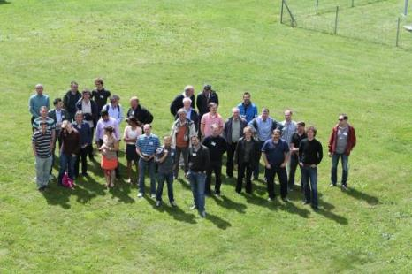
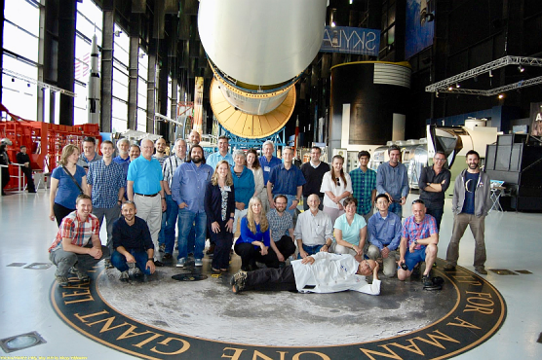
Lidar Working Group Meetings
LWG Meeting: 2016
Where: Payerne, Switzerland
When: Summer 2016
TOLNET + LWG Meeting: 2018
Where: Huntsville, Alabama
When: May 2018

Slide 9
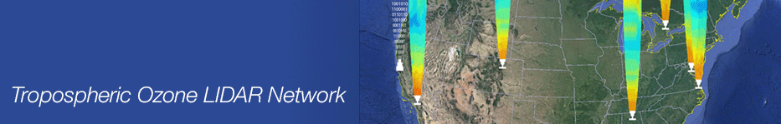
Common Interests
ECCC
ARC
ESRL
GSFC
JPL
LaRC
UAH
TOLNET & NDACC (lidars)
Current Common interests
Satellite validation
Theory and Analysis
Instrument Accuracy Assessment
Instrumental and data processing issues
Consider these Potential Common Interests
STE
Tropospheric Structure and Evolution
PBL
Air Quality observations -- 24/7 with coming geostationary satellites
Mobile Systems
5th Annual TOLNet Meeting 7-8 May 2017, Huntsville, AL USA
1st Joint TOLNet & NDACC Meeting 8-9 May 2017, Huntsville, AL USA

Slide 10
SG Issues from Station Reports

Slide 11
SG issues from station reports (1)
need for agency support for water vapor intercomparison campaign (MOHAVE) at Table Mountain in 2019
U.S. Army proposal to deploy new telecommunication devices at Mauna Loa that could impair the quality of future measurements (cf. MLO / Leblanc station report)
automatic processing of tropospheric ozone lidar data (cf. OHP / Ancellet station report)
tropospheric temperature by rotational Raman lidar for NDACC (cf. Payerne / Haefele station report)
OEM retrievals for Rayleigh temperature, water vapor, ozone … (cf. London, Ontario / Bob Sica)
Eureka data analysis, data archiving (cf. Tikhomirov / Drummond station report)

Slide 12
SG issues from station reports (2)
Practical support in processing and archiving the data. (Rome Tor-Vergata / Liberti)
Actions to make the data more visible and used (participation to conferences, publications). (Rome Tor-Vergata / Liberti)
Fundings. (Rome Tor-Vergata / Liberti)
NDACC / LWG Chairs can help
but we are not baby-sitters (processing, submission)
nor magicians (funding, publications, conferences)

Slide 13
Science Highlights

Slide 14
From B. Sica, A. Jalali
Optimal estimation for lidar
Rayleigh lidar temperature climatology (1994 – 2013)
classical Hauchecorne & Chanin
Optimal Estimation
Notes:
Make bigger

Slide 15
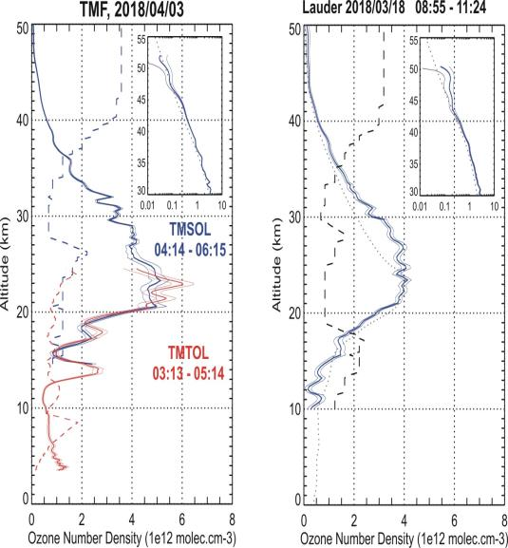
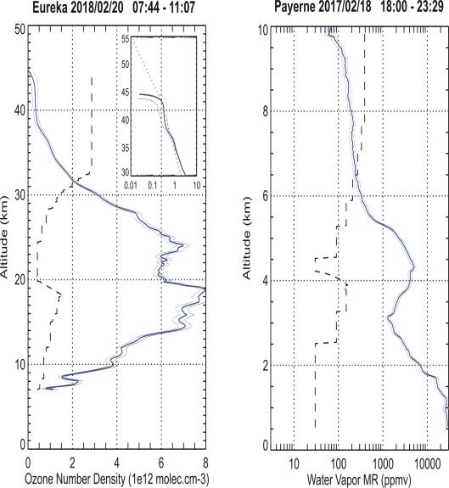
From T. Leblanc
New GLASS Data Processing examples
TMF O3
Lauder O3
Eureka O3

Slide 16
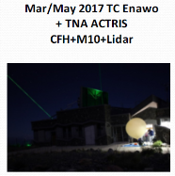
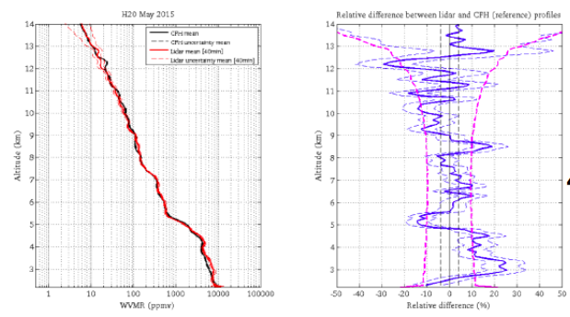
From V. Duflot
Water vapor validation
MORGANE Campaign
GRUAN CFH – Reunion Raman Lidar
40 min
profiles

Slide 17
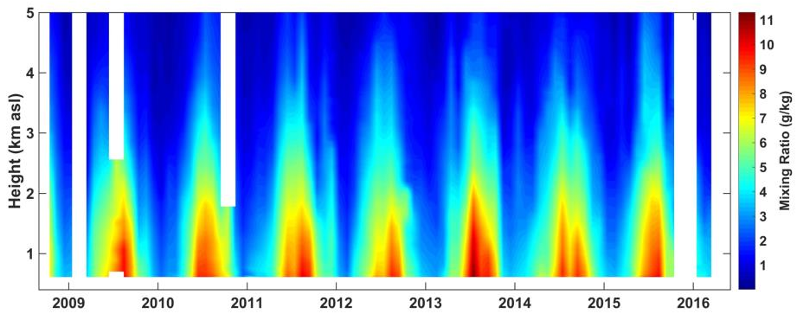
From G. Martucci
Payerne Raman Lidar
Tropospheric Water Vapour 2009 - 2017
Since 2008 RALMO has produced on average 1 profile every hour, i.e. 50% availability of tropospheric profiles.

Slide 18
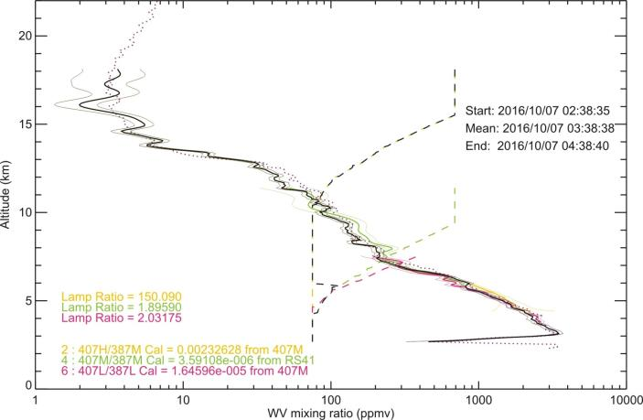
From T. Leblanc
Water vapor above TMF
~ 4-5 ppmv
October 2016

Slide 19
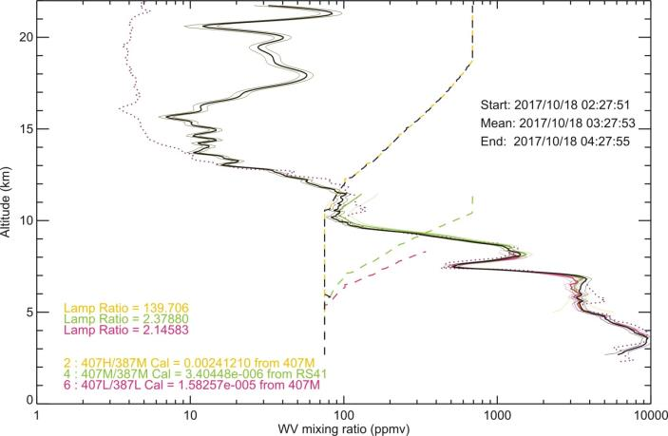
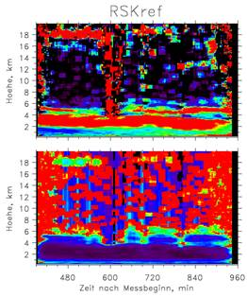
From T. Leblanc
Water vapor above TMF
10-40 ppmv !!!!
Jens Reichardt
Lindenberg
27 August 2018
October 2017
Fluorescence from
Canadian wildfire aerosol

Slide 20
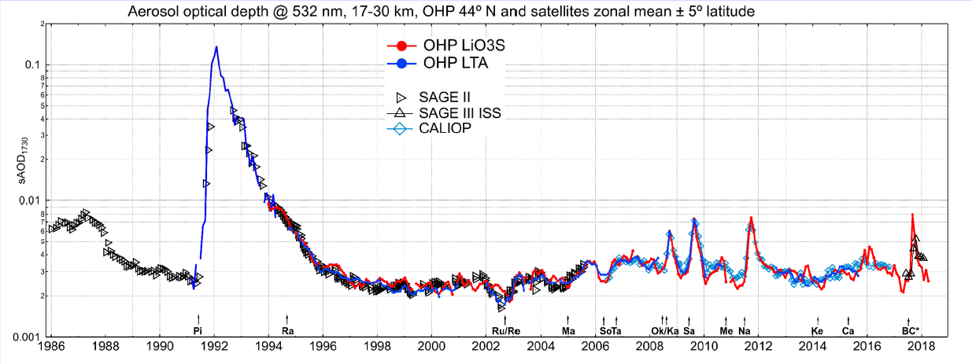
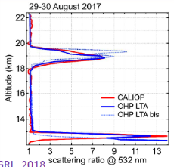
From S. Khaykin
Stratospheric Aerosol @ OHP

Slide 21
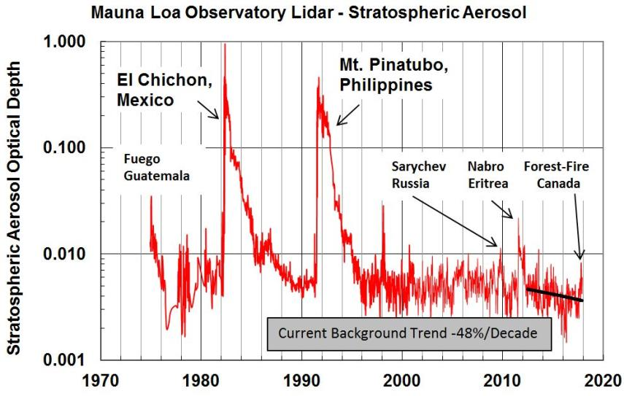
From J. Barnes
Stratospheric Aerosol

Slide 22
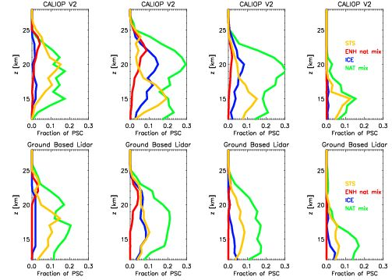
From M. Snels
Polar Stratospheric Clouds
Vertical distribution 2006-2010
CALIOP vs groundbased
McMurdo (2006-2010)
Relative abundances PSC types
PSC type | McMurdo gb [%] | McMurdo CALIOP [%]
STS | 25.3 | 24.1
NAT mixtures | 58.4 | 54.9
Enhanced NAT Mix | 2.9 | 5.6
Ice | 13.4 | 15.3
Blue = ice, Green = NAT mixtures
Red = enhanced Nat mix, Orange= STS

Slide 23
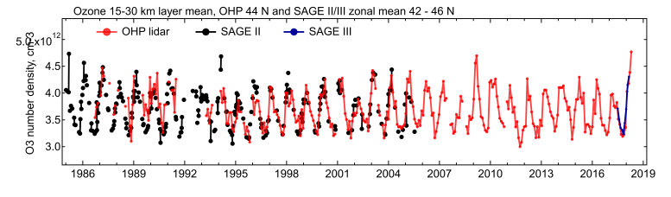
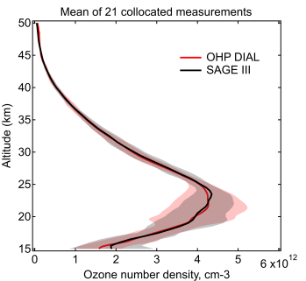
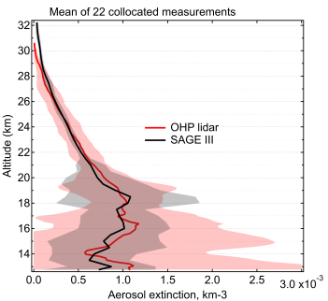
From S. Godin-Beekmann
SAGE III / ISS Validation @ OHP

Slide 24
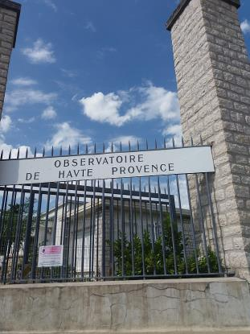
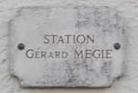
LAVANDE, Jul. 2017, Mar. 2018 @ OHP

Slide 25
From W. Steinbrecht
NDACC ozone time series
AI PO-11
Also: SPARC LOTUS
Ozone trends report

Slide 26
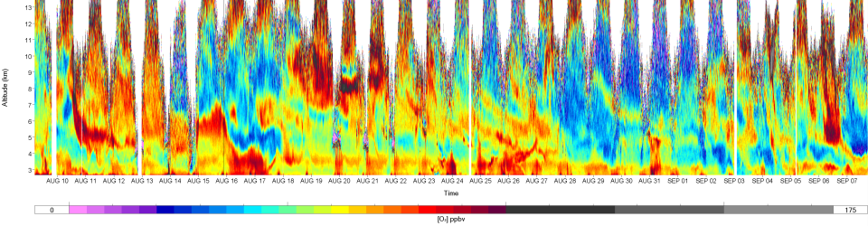
SCOOP Take Home Message: It’s just the beginning for TOLNet…
1. SCOOP results showed that AMOLITE, LMOL, TMT, TOPAZ and TROPOZ can be considered “validated”
2. Any instrumental change or data processing change should, in theory, be followed by re-validation
31-day continuous measurements by AMOLITE
0 20 40 60 80 100 125 150 175
O₃ ppbv
SCOOP
Is that the signature of the Blue Cut Fire?
Any volunteer to start a new, post-SCOOP study?
3. Automated systems like AMOLITE would surely add value to TOLNet

Slide 27
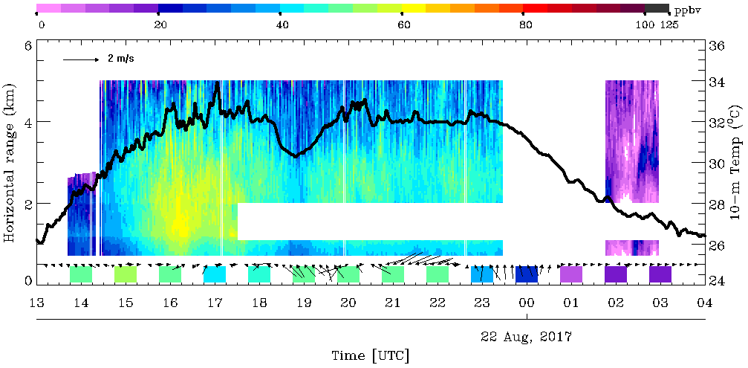
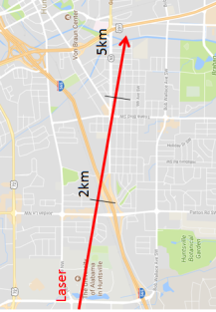
From S. Kuang
Tropospheric ozone in Huntsville
high ozone above highway
less ozone during solar eclipse
ozone titrated away at night
UTC = local + 6

Slide 28
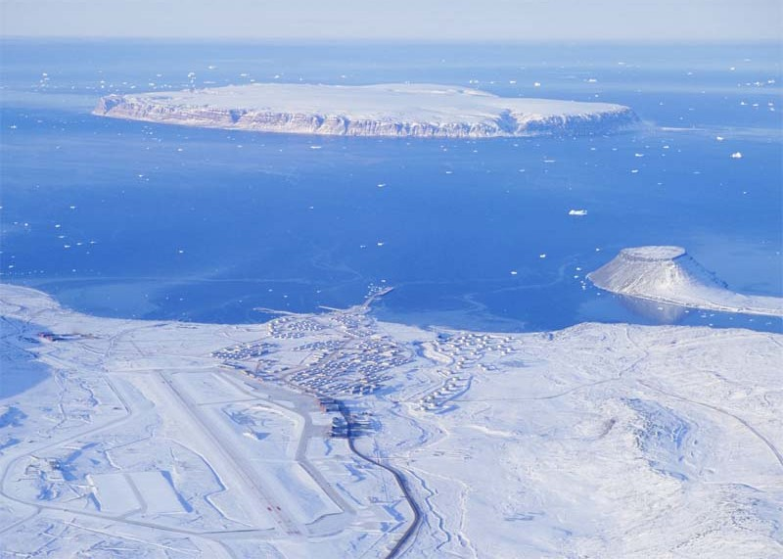
Thule
can we see clearer now?
Source: T. DiIorio, ENEA

Slide 29

where do we stand ?
NDACC lidars
unique for strato+meso temperature
unique for aerosol
good for strato + tropo ozone
water vapor
competition
satellites, sondes, GRUAN
EARLINET, ACTRIS
sondes, satellites(?), FTIR, µWave
sondes, GRUAN
NDACC lidar difficulties
lasers (and funding)
long nights
processing & data submission
aging & retirements
what can we do
not much?
(semi-)automatic operation
share methods & code, simplify, use batch files & better software
train people, keep positions

Slide 30
successes
part of SPARC-LOTUS ozone profile trend activity
part of 2018 WMO/UNEP ozone assessment
Lauder lidar looking good again
Reunion / Maido established & looking good
Dome-C transition worked
ISSI Team uncertainty standardization
OHP intercomparison + more planned
Khaykin et al. aerosol time series
challenges
Andoya, Rio Gallegos, Eureka, Sondre Stromfjord, Tor Vergata, …
slow submission, hdf still not widespread, hdf-aerosol missing
aging & retirement
perception of „same old“

